Slide 1

Using PowerShell and Python in Node.js
Chendrayan Venkatesan (Chen V)
@ChendrayanV

Slide 2
PS C:\> WhoAmI
Chendrayan Venkatesan (Chen V)
CDM MVP | MCTS SharePoint | MCP Exchange | ITIL V3 Foundation
Twitter : @ChendrayanV
LinkedIn : https://www.linkedin.com/in/chendrayanv/
An IT Professional one who use PowerShell at workplace to solve customer requirements! Strongly believe in the saying “Learning is a continuous process!”

Slide 3

Node and PowerShell?
Enjoy PowerShell on Your Web-Browser!

Slide 4
Inspired from……..
We Offer THREE kinds of service
GOOD-CHEAP-FAST
Pick any two
GOOD service CHEAP won’t be FAST
GOOD service FAST won’t be CHEAP
FAST service CHEAP won’t be GOOD
___________________________________________
☺ ☺ ☺

Slide 5
Agenda
Child Process
Node-PowerShell
Why Node and PowerShell?
Please don’t compare with Universal Dashboard – It’s awesome in different ways.
What will we achieve?
Demo

Slide 6
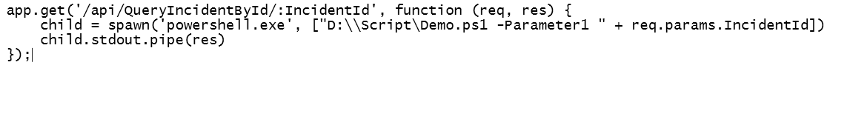
Node.js | Child Process
child_process.spawn()

Slide 7
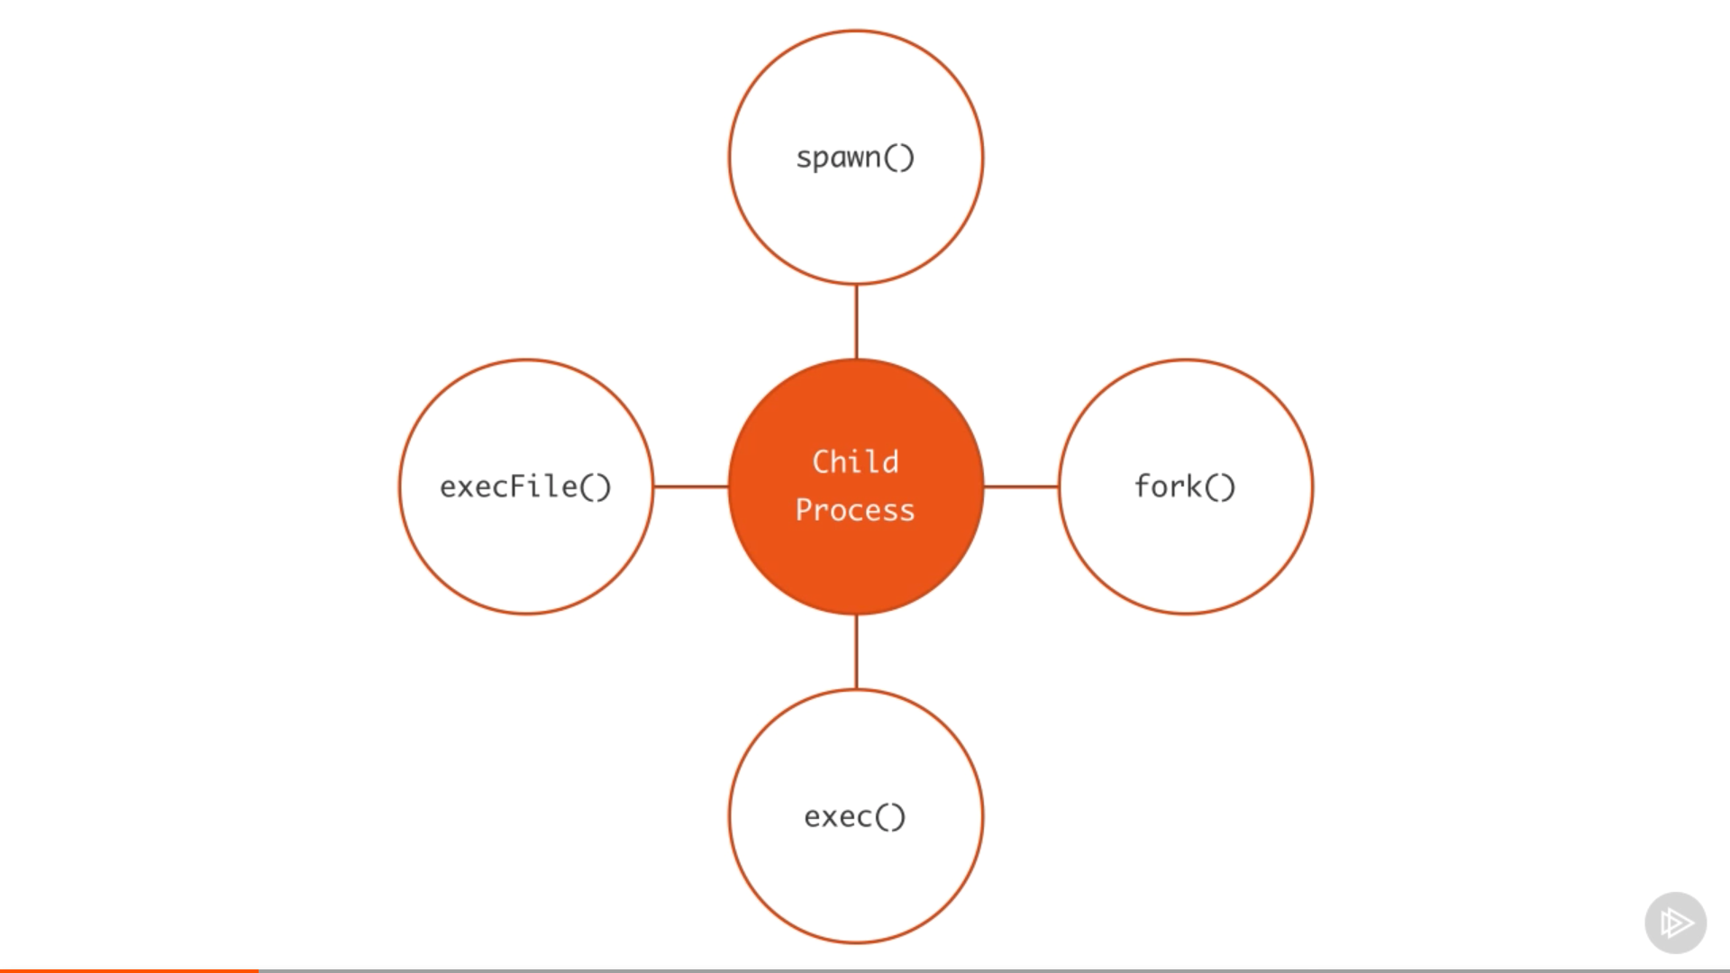
What else?

Slide 8
Node-PowerShell
Simple and Powerful – Hey not PowerShell ☺
Built using Child Process
A simple and Powerful packages
Documentation

Slide 9
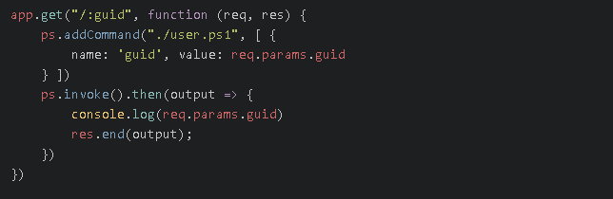
Hey Let’s Route! With PARAM!

Slide 10
Demo

